Slide 1

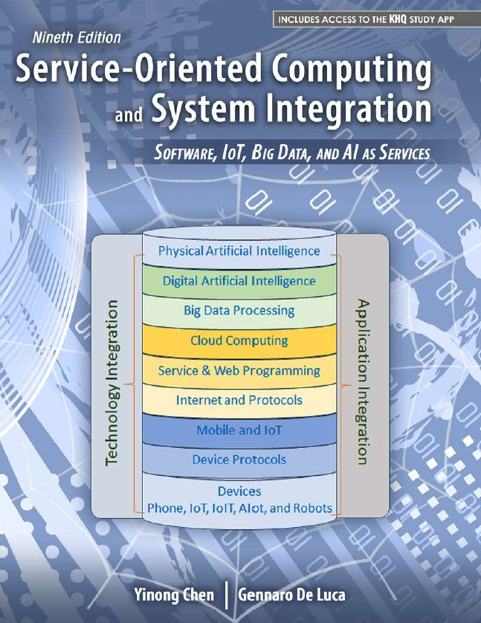
CSE 445/598
Distributed Software Development
Lecture 01 Part 2
Dr. Yinong Chen

Slide 2

CSE 445/598
Distributed Software Development
Chapter 1
Introduction to Distributed
Software Development
(Read Textbook Chapter 1)

Slide 3
Roadmap of Chapter 1
Computer Architecture
Software Architecture
Distributed Software Architectures
Client-Server Architecture (Two-Tier Architecture)
Three-Tier and Four-Tier architecture
Distributed Object Architecture
Design Patterns (Review)
Service-Oriented Architecture
Lecture 1

Slide 4
Computer Architecture
Computer Architecture
Flynn's classification
SISD
Single Instruction stream & Single Data stream
SIMD
Single Instruction stream & Multiple Data streams
MISD
Multiple Instruction streams & Single Data stream
MIMD
Multiple Instruction streams & Multiple Data streams
Vector or array computers
Fault-tolerant computer systems performing redundant computing on the same data stream and voting on the results
Computers with multi-core processors
Distributed systems
Networks
Simple computers
Distributed Computing Systems

Slide 5
Topics in Distributed Systems (MIMD)
Distributed Systems
(MIMD)
Hardware Architecture
Distributed Computing
Distributed Software Architecture
Network Architecture (Topology)
Distributed Computing
Distributed Software Architecture
Network Communication
(Protocols)
Paradigm of
Parallelism and distribution of computing
Client server
Tiered
Object orientation
Service orientation
Topology and connectivity of nodes. Star, ring, peer-to-peer, shared links
Layers of protocols,
Signal format
Packet format,
Error correction
Routing
Flow control
Session
Presentation

Slide 6
Review: Paradigms of Computing
Abstraction Level
Distributed Development
Centralized Development
Service-Oriented
Computing
Distributed
Object
Centralized Processing
Multi-thread
Programming
e.g., Java, C#
Logic
Programming
e.g.
Prolog
Object-Oriented
Programming
e.g. C++, Java,
C#, Python
Functional
Programming
e.g. LISP
Distributed
Processing
Procedural
Programming
e.g. C, Pascal
Imperative
Programming
e.g. Fortran
50s
60s
70s
80s
90s
00s
10s
Time

Slide 7
Features of the Computing Paradigms
Service-Oriented
Computing
Distributed
Object
Multi-threading
Programming
Parallel processing
Synchronization
Resource sharing
Autonomous services
Loosely coupling
Remote objects
Component-based composition
Remote invocation and binding
Separation of development (Distributed development)
Open standards and protocols
Platform-independent
Repository of reusable services
Internet-searchable services
Automatic discovering and binding
Collaboration negotiation
Dynamic re-composition
AI and Ontology-based reasoning
Object-Oriented
Programming
Abstract data types
Encapsulation
Inheritance
Dynamic/Lazy binding
Functional
Programming
Stateless
Side-effect free
Enforced modular design
Logic
Programming
Database
Relations
Query and matching
Reasoning

Slide 8
Software Architectures
Pipeline Architecture (Pipe-and-Filter) Architecture:
Messages are sent to its neighbor components, processed (filtered), and the result sent to the next component.
Components (Filters)
Components (Filters)

Slide 9
Software Architectures
Blackboard Architecture: A component is assigned to be the center for communication. All components communicate through the central component.
Notes:
E.g. Client – srvr Arch.

Slide 10
Software Architectures
Event-Driven Architecture
  The execution flows are determined (triggered) by the occurrences of events in parallel.
  An event-generating component takes subscription of other components;
  When an event occurs, the event-generating component will notify the components subscribed to the event;
  The notified components will call back / process
  Will be discussed in more detail in Chapter 2 and also in Chapter 9 (CSE446/598)
Notes:
Event-Driven Architecture is imp for DSD.
As our comp’s are distributed, U can do a remote procedure call [traditional way] but not good for DSD.
Btr way is to generate an event when reqd and let the services address.

Slide 11
Distributed Software Architectures
Architectural designs allowing software to execute on more than one logical processors;
Computing/processing is distributed over several computers rather than confined to a single machine;
Virtually, all large software systems today are distributed;
Distributed software architecture describes how the application functionality is distributed over a number of logical components and how these components are distributed across processors.
Choosing the right architecture for an application is essential to achieve the desired quality of service.

Slide 12
Characteristics of Distributed Systems
Resource sharing and synchronization
Openness and standardization
Concurrency and parallelism
Scalability
Dependability and Fault tolerance
Transparency

Slide 13
Issues to be Addressed in Distributed Systems
Compared to a centralized system, issues and challenges to be addressed in distributed systems include
Complexity
Communication and connectivity
Security and reliability
Unpredictability and non-deterministic problems

Slide 14
Eight Fallacies of Distributed Computing
The network is reliable.
Latency is zero.
Bandwidth is infinite.
The network is secure.
Topology doesn't change.
There is one administrator.
Transport cost is zero.
The network is homogeneous
Bill Joy and
Tom Lyon,
Sun Microsystems, 1991
Peter Deutsch, Sun Microsystems, 1994
Seven fallacies
James Gosling, added the 8th

Slide 15
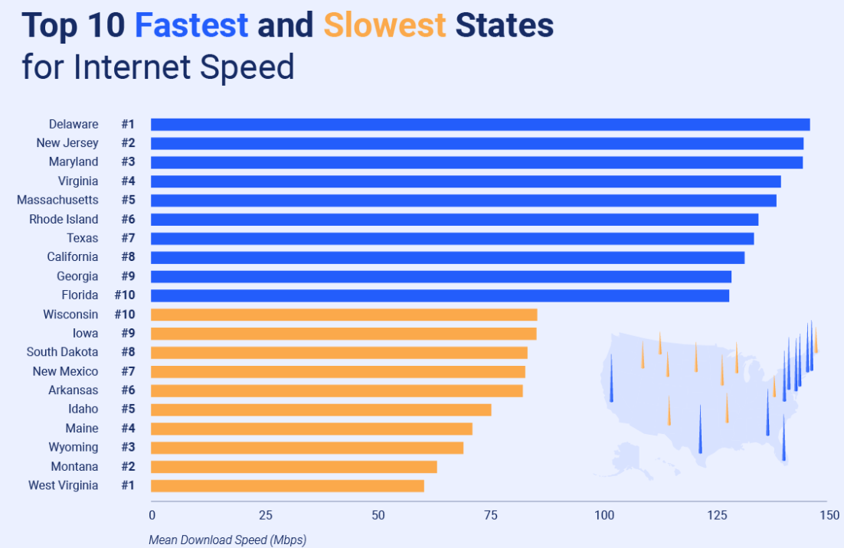
How Fast is Today’s High-Speed Internet?
ASU
BYENG
1gbps
FCC (Federal Communication Commission) Definition of “High Speed” 2015: 25 Mbps download and 3 Mbps upload,
2023 data:
Source: https://www.highspeedinternet.com/resources/state-of-the-internet

Slide 16
CSE 445/598
Distributed Software Development
Chapter 1
Introduction to Distributed Software Development
Lecture 2
Distributed Software Architecture
Dr. Y. Chen
https://myasucourses.asu.edu/

Slide 17
Roadmap of Chapter 1
Computer Architecture
Software Architecture
Distributed Software Architectures
  Client-Server Architecture (Two-Tier Architecture)
  Three-Tier and Four-Tier architecture
  Distributed Object Architecture
Design Patterns (Review)
Service-Oriented Architecture
Service-Oriented Software Development
Lecture 2

Slide 18
Distributed Software Architectures
Client-server Architectures
  Distributed services, which are called on by clients.
  Servers that provide services are treated differently from clients that use services
  Thin and fat client
Tiered (N-Tier) Architectures
  Two-tier architecture (client-server)
  Three-tier architecture
  Four-tier architecture
Distributed Object Architectures
  No distinction between clients and servers.
  Any object in the system may provide and use services from other objects
Service-Oriented Architecture
  Evolved from all types of architectures
  Not emphasize on the topology – dynamic architecture possible
  Open standards and protocols
  Separation of development duties (provider, consumer, and broker)
  Standards agreed and fully supported industry wide.
This Lecture

Slide 19
Client-Server (Two-Tier) Architectures
The application is modelled as a set of services that are provided by servers and a set of clients that use these services;
Clients know of servers but servers need not to know of clients;
Clients and servers are logical processes:
They could reside/running on different processors or on the same processor;
The mapping of processors to processes is not necessarily one to one.

Slide 20
Client-Server Systems and their Federation
Server
Virtualization of services
Virtual server A
Server
2
Server
1
Multi tenancy /
Loadbalancer
database
Cloud Computing
Federation
A server also manages the database
Virtualization of services
Virtual server B
Server
3
Server
4
Multi tenancy /
Loadbalancer
Notes:
Virtualizn-
we are gonna have 200 sites not 20o servers
CC – comes from Virtualizn, u have many srvs ; Virtualizn Vs CC is u have load balancer in CC [ auto scale up/down].

Slide 21
CSE445/598 Virtual Server WebStrar
in ASU SoD Cloud → AWS Cloud
Virtual
Servers
Multitenancy
One for each group
Each server has its own OS, DB, and software
Site 1
Multiple Folders for each tenant
One folder for each member
Site 2
Site Root Folder
.
.
.
Windows server, .Net 4
.
.
.
WebStrar
Site 100
Page 0
Page1
Page2
Page3
ASU SoD / AWS
Server on Demand Cloud
.
.
.
.
.
.
Page4
Page5
. . .
Page10
Site 199
No Isolation
Implemented
Isolation
Site 200
Notes:
Site~srvr
* don’t DEL given 10 pgs!
AWS Load balancing scalup or out?

Slide 22
Thin-Client and Fat-Client Architectures
Thin-client architecture
  All of the application processing and data management are carried out on the server.
  The client is simply responsible for running the presentation/GUI software.
Fat-client (Thick-client) architecture
  The software on the client implements the application logic and the interactions with the users.
  The server is responsible for data management (database) only.
  Example: Many game programs, Adobe Flash and MS Silverlight support Fat Clients, HTML5 can also support Fat Clients, where intensive processing and responsiveness are required.
Notes:
Any hybrid?

Slide 23
Traditional Three-Tier Architecture
Each layer may execute on a separate processor;
A more balanced approach, which allows for better performance than a thin-client approach and is simpler to manage than a fat-client approach;
A more scalable architecture - as demands increase, extra servers can be added.
Presentation
Layer (GUI)
Application
Processing Layer
Data Management
Layer

Slide 24
Example: A 3-Tier Internet Banking System
Client
Client
Client
HTTP
HTTPS
Web Server
for account
service
provision
Data Management Layer
Client
Database server
Customer
account
database
Presentation Layer
in Client Browsers
Business Logic Layer
in server
Database requests and responses

Slide 25
Four-Tier Architecture with a Service Layer
Each layer may execute on a separate processor;
Application is largely composed of existing services, running on a different server (repository), provided by external service providers;
This is an example of Service-Oriented Architecture (SOA);
SOA does not have to be in N-Tier. It can be a tree or graph too.
Presentation
Layer (GUI)
Not accessible outside
Application
Processing Layer
In-App Data
Management
Service Repository
Layer
Data
Management
Data Management
Layer outside App
Shared by many applications
Notes:
SOA/SOC seprates SRL from other

Slide 26
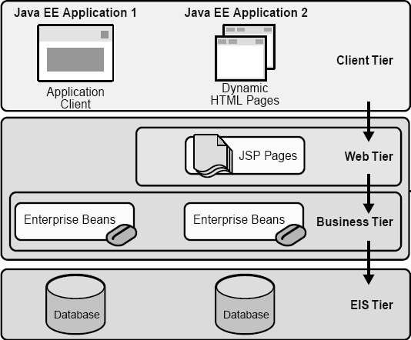
Four-Tier Architecture: Java EE Application
Source: Java Enterprise Edition
Client Machine
Java EE Server
Enterprise
Information
System
EIS Database
Server

Slide 27
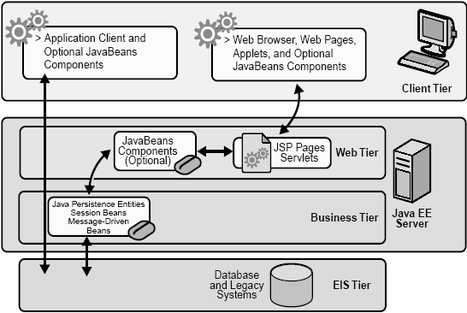
Java EE Application (not strictly tiered)
Thick client
Thin client

Slide 28
Distributed Object Architecture
In distributed object architecture:
There is no distinction between clients and servers
Each distributable component is an object that provides services to other objects and receives services from other objects
Object communication is through a middleware system called an object request broker (ORB, also called software bus)
However, more complex to design than client-server systems
No explicit separation of duties – The same person/team designs the same types of objects and the entire system, which requires complex skill to handle.
There are competing standards.
Notes:
THE INDUSTRY HAS MOVED AWAY FROM DISTRIBIUTED TO MICRO SERVICES!!

Slide 29
Distributed Object Architecture Example
Objects
ORB / Software Bus
Objects

Slide 30
Advantages of Distributed Object Architecture
It is an open system architecture that allows new resources to be added to it as required;
The system is flexible and scalable;
It is possible (e.g., written in the same language) to reconfigure the system dynamically with objects migrating across the network as required.
It allows the system designer to delay decisions on where and how services should be provided;

Slide 31
Uses of Distributed Object Architecture
As a logical model that allows you to structure and organize the system.
  You focus on providing application functionality solely in terms of services and combinations of services;
As a more flexible approach to the implementation of client-server systems.
  The logical model is a client-server model.
  Both clients and servers are realized as distributed objects communicating through a software bus.
  The server does need to not know the client.

Slide 32
CORBA: Common Object Request Broker Architecture
Defined by the Object Management Group (OMG)
An international standard for an Object Request Broker - middleware to manage communications between distributed objects/components
Enable software components written in multiple computer languages and running on multiple computers to interoperate;
Several implementations of CORBA are available;
DCOM was an alternative (competing) approach by Microsoft to object request brokers.
CSE445 before 2006:
Java Distributed Computing with CORBA
Notes:
IBM & others still support CORBA but no more realeases [EOL]

Slide 33

CORBA
CORBA objects are comparable, in principle, to objects in C++ and Java;
The objects have a separate interface defined by the Interface Definition Language (IDL) that is similar to C++;
There is a mapping from this IDL to programming languages (C++, Java, etc.);
Therefore, objects written in different languages can communicate with each other;
CORBA can be used for implementing a Client-Server Architecture
Client / App
Server
Interface
Service code
IDL
Stub
Skeleton
CORBA
ORB
CORBA
ORB
→
Network

Slide 34
Object Request Broker (ORB)
Publish / register
The ORB handles object communications.
A service provider makes its services known via stubs.
Using an ORB, the calling object binds an IDL stub that defines the interface of the called object.
Calling this stub results in a call to the ORB, which then calls the required object through a published IDL skeleton that links the interface to the service implementation.
Agent / broker
Client / App
Server
Interface
Service code
IDL
Stub
Skeleton
CORBA
ORB
CORBA
ORB
Network

Slide 35
ORB-based Object Communication
Distributed Object Architecture: Objects can use each other’s services.
. . .
. . .
IDL
Stub
IDL
Stub
IDL
Stub
IDL
Stub
Object Request Broker
Object Request Broker
. . .
Network

Slide 36
MS DCOM: Distributed Component Object Model
Originally, Microsoft distributed object system was called OLE (Object Linking and Embedding) and then “Network OLE”;
It was extended to Microsoft's COM (Component Object Model) in 1993, which provided the communication capacity among objects;
Windows 2000 significantly extended COM and renamed it COM+. Then, COM+ becomes DCOM later;
DCOM allows software components to distribute across several networked computers to communicate with each other;
All these technologies are integrated into and replaced by Visual Studio .NET, which supports both Object-Oriented and Service-Oriented Architecture (SOA).
Notes:
COBRA was for C++ & Java
u see many com, com+ not DCOM as they switched service oriented arch around that time.

Slide 37
Enterprise Service Bus (ESB)
Shifting from Distributed Object Orientation to Service Orientation
An ESB provides an abstraction layer on top of an implementation of an enterprise messaging system;
It allows integration architects to exploit the value of messaging without writing code.
It is the service-oriented version of ORB.
Contrary to the more classical Enterprise Application Integration (EAI) approach (tightly coupled), ESB provides a loosely coupled platform to support distributed functions, with distributed (independent) deployment where needed, while still working in harmony.
CSE446 / CSE598

Slide 38
Modeling Business in SOA
Turn this model …
…into this (SOA).
Depository
Vendor Setup
Vendor
Process Servers
Banks
Customer Perceived
Application
Service
Application
Service
Application
Service
Application
Service
Budget
Maintenance
(Imaging)
NEW Soundscan
Shows
VAN
Universal Account
In-Stock
Analysis Tool
Printer
S20-Sales
Mesa Data
Reconcilliation
Maintenance
Polling
I13- Auto
Hand Scan
Printer PO
Customer
Replenishment
Apps
Reports
Insertions
Sales
Order
Due Dates
Calendar
Orders
Print Costing
Corrections
Warehouse
Broadcast
General
Invoice App
Management
Stores & Mrkts
Filter
Maintenance
Interface
PO
Smart Plus
Millennuim 3.0
Smart Plus
Sales Posting
Launcher
Cell
Return to
Tally Sheet
Millennium
Phones
D01 Post Load
Vendor
Credit App
Stock Options
Employee
Equifax
Billing
Solution
Satellite
Resource
Change Notice
A04 - Cust
Software
System
-Promo
Scheduling
On-line New
Refund Chks
DFK
1
Analysis
Interface
Interface
Interface
Resumix
Hire Entry
P01-
AAS
Price
Employee
Marketing
Cobra
P09 - P17
Masterfile
Support
Bus Systems
Cyb.
ABC
website
- ISP
CTS
Co
Home
Cycle Physical
Tracking
ACH
Prodigy
V04-Sign
Deliveries
Inventory
Banks - ACH and Pos to
POS
System
CTO
-
Pay
Transfers
Host to AS400
Plan Administrators
Communication
(401K, PCS, Life)
Spec Source
Stock
SKU Tracking
Status
Counts
Price
Testing
Supplier
Employee
Intercept
Sales
Scanning
Layaways
Compliance
Purchase
Tax
Spec
PO
Scorecard
Source
Receiving
SKU
Mkt
Performance
Bonus/HR
Reactions
Polling
Price Management
Inventory Info
Coop
SKU Selection
DRK
System
Customer Repair
Tool
ABBX
Tracking
I35 Early Warning
Planning
Rebate
SKU Rep
System
Store
Transfer
SKU
Purchase
Monitor
PowerSuite
General
Information
Order
Ad Expense
Ledger
Store
Tex A
Sign
Scorecard
System
N.
Count Corrections
Store Budget
Interface
Interface
Interface
Interface
Tx
Writer
Merchandise
Media
Reporting
Workspace
Analysis
BMP - Bus
EDI
performance Mngt
Mngr Approval
Coordinator
Batch Forcasting
AIMS
AP
Journal Entry Tool Kit
Ad Measurement
Cellular
INVENTORY CONTROL APPS - PC
INVENTORY CONTROL APPS - PC
ACCTS REC APPS - PC
Ad
AIMS
Rollover
OTHER APPS - PC
Launcher
Reporting
House
PSP
Op.
Recon
Charges
Capital
File
Data Warehouse
In-Home
Projects
SS
Connect 3
Credit
Repair
Connect 3
Connect 3
Cash Receipts/Credit
Application
Service
Application
Service
Application
Service
Application
Service
Fixed
PDF Transfe
Reports
Misc Accounting/Finance Apps - PC/NT
Warranty
Assets
Billing
Repair
Cash Over/
System
Short
Rich business abstractions describe the application interface
Decouples the interfaces from the business applications
The number and complexity of the interfaces are reduced
Business applications and their interfaces become reusable
Source: Carter Sandy Keynote Presentation, IBM, 2005
Notes:
So how does web services decouple the interfaces from their applications?
1) It uses a programming model that allows a rich abstraction of both the business app and the interface.
2) By abstracting the interfaces, they can be clearly separated from the business applications.
3) This enables you to reduce the number and complexity of those interfaces and.
4) It allows you to reuse both the interfaces and the business applications.
The problem is that you still have to build, find, and manage all of those interfaces somewhere.

Slide 39
The ESB shrinks those interfaces further
Turn this (web services)…
…into this (SOA)
Application
Service
Application
Service
Application
Service
Application
Service
Application
Service
Application
Service
Application
Service
Application
Service
Interface
Interface
Interface
Enterprise Service Bus
Interface
Interface
Interface
Interface
Application
Service
Application
Service
Application
Service
Application
Service
Application
Service
Application
Service
Application
Service
Application
Service
Decouples the point-to-point connections from the interfaces
Allows for dynamic selection, substitution, and matching
Enables more flexible coupling and decoupling of the applications
Enables you to find both the applications and the interfaces for re-use
Source: Carter Sandy Keynote Presentation, IBM, 2005
Notes:
The ESB shrinks the interfaces further.
1) It virtualizes the interface, or in other words, it decouples the point-to-point connections from the interfaces themselves.
2) The interfaces are put into a third party broker which helps you manage the interfaces better.
3) The enables faster and more flexible coupling and decoupling of applications.
4) Because you can find all of the applications and the interfaces, you can then reuse both.

Slide 40
Software Engineering Review: Design Patterns
Design patterns will be used in the later chapters
Hardware Patterns
Software Patters
Patterns
Architectural Patterns
Computing Patterns (Computing paradigms)
Design Patterns
A design pattern is a general reusable solution in software design.
A design pattern is not a finished design. It is
  a template for solving a problem that can be used in many different situations;
  an interface that can have different implementations.
Algorithms of solving a problem is not a part of the design pattern – They belong to the implementation detail / computing pattern.
Not all software patterns are design patterns. Design patterns deal specifically with problems at the level of software design.
Notes:
CSE360 - Design Patterns course THEORY

Slide 41
Review: Classification of Design Patterns
Creational Patterns:
Abstract factory, Factory method, Lazy initialization, Object pool, Singleton, Utility, …
Structural Patterns:
Adapter, Decorator, Façade, Proxy, …
Behavioral Patterns:
Command, Iterator, Mediator, Observer, State, …
Concurrency Patterns:
Active Object, Monitor, Read-Write Lock, Reactor, …
Source: CSE360 Text, Software Engineering, Pearson, 10th Edition, by Ian Sommerville.

Slide 42
Review: Creational Patterns
Abstract factory: Provide an interface for creating families of objects without specifying their concrete classes.
Factory method: Define an interface for creating an object, but let subclasses decide which class to instantiate. Factory method lets a class defer instantiation to subclasses.
Lazy initialization: Tactic of delaying the creation of an object, the calculation of a value, or some other expensive process until the first time it is needed.
Object pool: Avoid expensive acquisition and release of resources by recycling objects that are no longer in use
Singleton: Ensure a class only has one instance, and provide a global point of access to it.
Utility: A class with a private constructor that contains static methods only.

Slide 43
Review: Structural Patterns
Adapter: Convert the interface of a class into another interface that clients expect.
Decorator: Attach additional responsibilities to an object dynamically. Decorators provide a flexible alternative to sub-classing for extending functionality.
Façade: Provide a unified interface to a set of interfaces in a subsystem. Façade defines a higher-level interface that makes the subsystem easier to use.
Proxy: Provide a surrogate or placeholder for another object to control the access to it.

Slide 44
Review: Behavioral Patterns
Command: Encapsulate a request as an object, thereby letting you parameterize clients with different requests.
Iterator: Provide a way to access the elements of an aggregate object sequentially without exposing its underlying representation.
Mediator between objects: Define an object that encapsulates how a set of objects interact. Mediator promotes loose coupling by keeping objects from referring to each other explicitly, and it lets you vary their interaction independently, e.g., we could use cse445instructor@asu.edu, instead of yinong@asu.edu
State: Allow an object to alter its behavior when its internal state changes.
Observer: Define a one-to-many dependency between objects so that when one object changes state, all its dependents are notified and updated automatically.

Slide 45
Review: Concurrency Patterns
Active Object: It decouples method execution from method invocation. The goal is to introduce concurrency, by using asynchronous method invocation and a scheduler for handling requests.
Monitor: It is an approach to synchronize two or more tasks that use a shared resource, usually an object.
Read-Write Lock: It allows concurrent read access to an object but requires exclusive access for write operations.
Reactor: It is a concurrent programming pattern for handling service requests delivered concurrently to a service handler by one or more inputs. The service handler then de-multiplexes the incoming requests and dispatches them synchronously to the associated request handlers.

Slide 46
Applications of These Design Patterns
The patterns will be further discussed in the context of their applications, in text Part I (445) and Part II (446).
Creational Patterns:
Abstract factory, Factory method, Lazy initialization, Object pool, Singleton , Utility, …
Structural Patterns:
Adapter, Decorator, Façade, Proxy, …
Behavioral Patterns:
Command, Iterator, Mediator, Observer, State, …
Concurrency Patterns:
Active Object, Monitor, Read-Write Lock, Reactor, …
Chapters 4, 5, 8, 9, 10
Chapters 3, 5, 8
Chapters 5, 8, 10
Chapters 2, 5

Slide 47
CSE 445/598
Distributed Software Development
Chapter 1
Introduction to Distributed Software Development
Lecture 3
Service-Oriented Architecture and Concepts
Dr. Y. Chen
https://myasucourses.asu.edu/

Slide 48
Overview and Roadmap to
Service-Oriented Software Development
Basic Concepts
  Three-Party Model of Service-Oriented computing
  SOA, SOC, SOD, Web services
  Development Cycle
XML, SOAP, WSDL
Service Provider
Service Broker
Service Requester
SOA Impact
Myths and Facts
Lecture 3
Three-party model
Lecture 4

Slide 49
Distributed Development: Separation of Responsibility
The Three-Party Model of Service-Oriented Software Development
Not a part of the model
Developers who understand database, ontology, searching, and matching
End user
White pages
Yellow pages
Traditional object-oriented programmers, active objects hosting
Software engineers who understand the application domain
Service brokers
Green pages
Registry
Registry
Service repository
Internet
Application builders
Service providers
Applications
Active Objects
Service requesters
Service developers
Notes:
Srv Broker follow a Std.

Slide 50
A Scenario of the SO Software Development and Tools
Programming
languages:
C++, C#
Java, Python
Directory of services
UDDI / WSDL / SOAP
ebXML, RDF/S, OWL
Ontology
(3) Registering
Service
Development Envir:
Visual Studio,
Flask, Django
Java EE / Eclipse / NetBeans
Service brokers
Registry
Registry
(5)
Found
(2) Publishing
Internet
(4)
Finding
Application builder
Service providers
(6)
Binding
(7) SOAP/HTTP call
(1) Developing
Applications
Active Objects
(8) Results
Application development platforms
Specification languages VS, WebSphere, SCA/SDO, WF, WSFL, BPEL, Django for composition, code generation, in addition to use programming languages
Using Web Service standards:
XML, WSDL, RDF, OWL, ontology
Notes:
U can use multi threading to start/run ur services instead of Serv Dev Env’s.
Serv are active obj’s they recieve msg which they process &sent back

Slide 51
Web Services in Web Applications
Brokers
Application builders
Service Directory
UDDI or ebXML
Other Web
Services
Service
requesters
SOAP/HTTP
Global Data
WSDL Interface
Local Data
Service / Object
Database and Ontology
IDE (.Net or Java EE)
Big Data
Programming languages
Data Infrastructure
Web Services
Service hosting infrastructure, e.g., servers or cloud computing
A program consists of algorithms and data
Notes:
Service / Object are active running obj.
Publishing serv is sending WSDL to Broker
Service hosting – they start each obj as active running obj.

Slide 52
Definitions and Terminologies
A service is the interface between the producer and the consumer.
From the service provider's point of view, a service is a function module that is well-defined, self-contained, and does not depend on the context or state of other functions. A service is often implemented by an active object.
  Services can be newly developed modules or just wrapped around existing (legacy) software to give them new interfaces.
From the application builder's point of view, a service is a unit of work done by a service provider to achieve desired end results for a service consumer (an application builder, not an end user).
A service normally does not have the human user's interface. Instead, it provides loosely coupled Application Programming Interface (API), with standard interface, so that a service can be discovered and invoked by a computer program.
For human users (end users) to use services, a (graphic) user interface needs to be added – forming a (Web) application.

Slide 53
Definitions and Terminologies (contd.)
Service-Oriented Architecture (SOA): Software consisting of a collection of loosely coupled and platform-independent services that communicate with each other through standard interfaces. SOA does not concern developing
operational software.
Service-Oriented Computing (SOC) refers to the paradigm that represents computation in SOA. A level deeper than
SOA, incl. algorithms and data structures.
SOA and SOC are often used interchangeably.
Web Services are services accessible over the Web. As an architecture, it refers to Web-based SOA and a set of enabling Web technologies, including XML, JSON, SOAP, WSDL, HTTP, UDDI, and ebXML. Two types of Web services:
  SOAP/WSDL Services (heavy duty services)
  RESTful Services (lightweight or micro services)
Architecture Pattern
Computing Pattern
Notes:
SOA can be used locally(offline).
RESTful Services ~ collection of methods
No class concept, only methods
U can still use clss, consider each method as a cls.
Mainly used for Front-end.

Slide 54
Definitions and Terminologies (contd.)
CSE445 does SOD!
Service-Oriented Development (SOD)
  concerns the entire software development cycle based on SOA concepts and SOC paradigm.
  involves current technologies and tools to effectively produce operational software:
    Development environments: VS, Java EE,
    Flask, Django, NetBeans, WebSphere, etc.;
    Databases, SQL, Oracle, BD, XML DB, etc.;
    Deployment and hosting environment: Server, cloud: SoD, AWS Cloud, Google Cloud, MS Azure, etc.

Slide 55
OO Development versus SO Development
SO Protocols/
Languages
SO Concepts
SO IDEs/Tools
SO Development Cycles
Service
orientation
Loosely
coupled
Remote
binding
Dynamic
composition
Standard
interfaces
XML
WSDL
SOAP
RDF
OWL
BPEL
SCA/SDO
PSML
Visual Studio
Flask, Django
NetBeans
Oracle SOA
suite
JDeveloper
Java EE
WebSphere
ebXML
Service development in OOC
Interface definition / wrapping
Service hosting / registration
Application specification
Service search
Remote binding
Operation
Dynamic configuration
Directory
Repository
Ontology
Match
OO Concepts
OO Languages
OO IDEs/Tools
OO Development Cycle
Object
orientation
Inheritance
Polymorphism
Dynamic
binding
C++
C#
Objective C
Java
Python
Smalltalk
CORBA
Eclipse
UML
GCC
Visual Studio
Specification/Modeling
Verification/Model checking
Design / Coding
Validation / Testing
Operation
Maintenance

Slide 56
Component-Based Development
Bricks and Tiles
Traditional
Component-based

Slide 57
Component-Based Software Development
Organization X:
Component library
Organization Y:
Component library

Slide 58
Service-Oriented Software Development
Design Pattern?
Application
proxy
proxy
proxy
proxy
proxy
Auto-searchable
Found
Standard
Interface
Service broker
Registration
Organization X:
Component library
Organization Y:
Component library
Organization Z:
Component library
Notes:
U nvr send codefrom ur appn to broker, we create a proxy[Serv. Implementr]

Slide 59
Roadmap
Basic Concepts
XML, SOAP, WSDL
Services
Service Broker
Application Building
SOA Impact
Myths and Facts
Next lecture:
Three-party model

Slide 60
XML
XML (Extensible Markup Language) is a Meta language :
Used for defining other languages. Most languages and protocols in SOC paradigm are based on XML
  BPEL (Business Process Execution Language)
  RDF, RDF Schema, and OWL
  SOAP
  WSDL
  UDDI
Similar to html to some extent, but you can define your own tags to quote data
You can define attributes to each data item for semantic meanings. Data transferred between Web services are often encoded in XML

Slide 61
HTML versus XML
<html>
<h1>International Conference on Software Engineering and applications, November 14-16, 2005, Phoenix, AZ, USA</h1>
<li>Software design and development</li>
<li>Software engineering applications</li>
<li>Software security</li>
</ br>
</html>
<?xml version="1.0">
<conference>
<title>International Conference on Software Engineering and applications</title>
<date>November 14-16, 2005</date>
<location>Phoenix , AZ, USA </location>
<keyword>Software design and development</keyword>
<keyword>Software engineering applications</keyword>
<keyword>Software security</keyword>
</conference>

Slide 62
Differences between HTML and XML languages
 | HTML | XML
Purpose of tags | Formatting data for display. | Define tags and attributes on data that can be interpreted by human and machine.
Syntax of tags | Tags may be left open, e.g., <li>, <br>. | All tags must be in pair, e.g., <li> </li>, <br> </br>
Semantics of tags | Tags are predefined with given format meaning. Tags are limited. | The user can choose any tags and the meanings can be defined separately. Assigning meanings to a set of tags defines a vocabulary and thus a new markup language.
Schema | The schema is fix and implied | Need a schema file to define the tags and the structure
Semantics of data | It is difficult for machine to understand. For example, is “Phoenix” a part of the title? | Once the tags are defined, it is easy for the machine to understand. “Phoenix” is a location, not a part of the title.

Slide 63
SOAP: Simple Object Access Protocol
SOAP is used for transporting messages between
Web services and applications
A SOAP message is an XML document
Like any communication protocol, a SOAP message consists of wrapper information and payload;
The format of SOAP message is as follows:
A SOAP message is often wrapped in an HTTP (Hypertext Transfer Protocol ) message and sent as an HTTP packet over the internet:
<soap:Envelope>
<soap:header> . . . </soap:header>
<soap:body> . . . </soap:body>
</soap:Envelope>
HTTP Package
SOAP Package
Notes:
SOAP can carry – method names,..

Slide 64
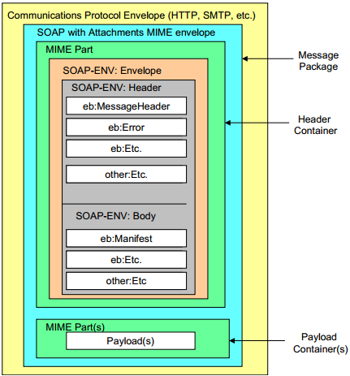
Example: ebXML Message Structure https://www.oasis-open.org/committees/ebxml-msg/documents/ebMS_v2_0.pdf
MIME (Multipurpose Internet Mail Extensions) is a standard that extends the format of email to support:
Text
Non-text attachments
Message bodies with multiple parts
Header information in non-ASCII character sets
Notes:
SOAP allows attachments[Vids, ..] outside its MIME part.

Slide 65
WSDL: Web Service Description Language
WSDL is used for describing Web services (interfaces), including four critical aspects of Web services:
  Functionality of the services described in standard taxonomy;
  Data type of each parameter and the return type of the function (service) call;
  Binding information about the transport protocol to be used, usually, SOAP;
  Address (URL) for locating the specified service.
The last three aspects can be automatically generated.
Web services described in WSDL can be searched, matched, and discovered based on the requirements.
Web services described in WSDL provides discovery and remote call details.

Slide 66
XML-Based WSDL Document’s Elements
root
<definitions>, service name, namespaces
<Service>
. . .
<Service>
<port>
(URL)
<port>
(URL)
. . .
<binding>
(soap)
<binding>
(soap)
<portType>
<portType>
<operation>
<operation>
<types>
<types>
<message>, in
. . .
<message>, in
<types>
<types>
<message>, out
<message>, out

Slide 67
SOC Services vs. OOC Classes
SOAP/WSDL Services
WSDL interface → Language interface
Namespace of services → Namespace of classes
Service → Class/Object
Operation → Method
Operation type in → Method parameter
Operation type out → Method return value
Binding protocol (SOAP) →
Service address (URL) →
RESTful Services → Resource → Method
Service → Resource → Method

Slide 68
Summery: Key SOA, SOC & SOD Concepts
Component-based composition with open standards and protocols
Remote objects, binding, and remote invocation
Autonomous services with platform-independency: Using proxy, instead of code integration
Loosely coupling using message-based communication and asynchronous communication is supported
Web-based repository of internet-searchable and reusable services
Automatic discovering and binding, based on collaboration negotiation, dynamic re-composition, and ontology-based reasoning.
Separation of development: service provider, broker, client

Slide 69
Overview and Roadmap to
Service-Oriented Software Development
Basic Concepts
XML, SOAP, WSDL
Services and Service Development
Service Registry and Repository
Service Requests and Application Building
SOA Impact
Myths and Facts
Lecture 4

Slide 70
CSE 445/598
Distributed Software Development
Chapter 1
Introduction to Distributed Software Development
Lecture 04
Service-Oriented Software Development
Dr. Y. Chen
https://myasucourses.asu.edu/

Slide 71
Overview and Roadmap to
Service-Oriented Software Development
Basic Concepts
XML, SOAP, WSDL
Services and Service Development
Service Registry and Repository
Application Building
SOA Impact
Myths and Facts
Three-party
model
Lecture 4

Slide 72
Web Services
Basic Concepts
XML, SOAP, WSDL
Services
Service Broker
Application Building
SOA Impact
Web 2.0 and
Semantic Web
Service brokers
Registry
Registry
Application builder
Service providers
Applications
Web Services

Slide 73
Web Service (WS)
Web Services are building blocks of SOC software
  SOAP/WSDL services have an standard interface in WSDL
  RESTful services use HTTP without using SOAP/WSDL
WS can be remotely invoked via a message in a standard protocol, e.g., SOAP, HTTP – It is NOT a remote procedure call
  Loosely coupled vs. tightly coupled
  Data flow vs. control flow
Web Services are platform-independent, it can be written in any languages: Java, C#, C++, Python, etc.
Every piece of program can be wrapped into a WS
Every WS can be placed in an internet-searchable repository
In the near future, most services required will be available (not necessarily free). There is less need of writing new services. However, there is always a need of writing better services.

Slide 74
Main Web Service Authoring Tools (1)
C# Web Services on Visual Studio
Choose a Web Service templates, WCF, WF, etc.
Define an ordinary class with data members and mainly methods in C#;
Choose methods to be remotable by adding
[operation contract]
Compile and run the class:
  service will be generated;
  WSDL file and/or URL of the Web service will be generated;
  SOAP/HTTP call interface will be generated;
There is little difference with writing a C# class
Not very useful
Notes:
WSDL file – It will have operation contract

Slide 75
Main Web Service Authoring Tools (2)
Java Web Services
Define an ordinary class with data members and methods in Java;
There are different ways to wrap a Java class into a Web service (generate WSDL and SOAP files)
  NetBeans, Download: https://netbeans.org/
  Eclipse with WS extension,
  Java EE,
  Community projects and third parties, e.g.,
  Apache Tomcat tool,
  IBM tools such WebSphere,
  http://www.eclipse.org/webtools/initial-contribution/IBM/evalGuides/WebServicesToolsEval.html
  JDeveloper / Oracle SOA Suite
  Manually write host and extract the required information and wrap them into WSDL and SOAP syntax
Notes:
Apache Tomcat – Service hosting tool.
In java u write code as usual & then conv it to services using tools.
Vs has IIS service tool for C#

Slide 76
Main Web Service Authoring Tools (3)
Python Web Services
There are different environments for defining Python
Web RESTful services
  Flask
  Django
  FasrAPI
  CherryPy
  Pyramid
  Visual Studio + Flask:
  https://docs.microsoft.com/en-us/visualstudio/ide/quickstart-python?view=vs-2022
  Visual Studio + Django
  https://docs.microsoft.com/en-us/visualstudio/python/learn-django-in-visual-studio-step-01-project-and-solution?view=vs-2022
  Grok
  TurboGears
  Web2Py
  Bottle
Notes:
In PY, U mostly type each method i.e.; each method is a service.

Slide 77
Web Services are Wrapped Classes/Objects
Return value in XML/SOAP/HTTP
To UDDI server
Service
requester
Remote invocation in
XML/SOAP/HTTP
WSDL Description
for UDDI publication
RESTful
Reactor
Web service interfaces in WSDL
Automatically
generate the
Service interfaces
Function call
Return value
Service agent
Functions/Methods written in C# / Java / Python
Manually write the functions/methods in the classes in C# or in Java,
each function corresponds to a service
Notes:
A published service will have the same address for all the requestor’s.
Restful service doesn’t have any interface so efficient but u need to read the manual for giving I/P & getting O/P.

Slide 78
Roadmap
Basic Concepts
XML, SOAP, WSDL
Web Services
Service Broker: Registry and Repository
Application Building
SOA Impact
Myths and Facts
White pages
Yellow pages
Service brokers
Green pages
Registry
Found
Internet
Publishing
Find
Application builder
Service providers
SOAP call
Applications
Web Services
Results
Notes:
Registry – A list showing wt services are available.

Slide 79
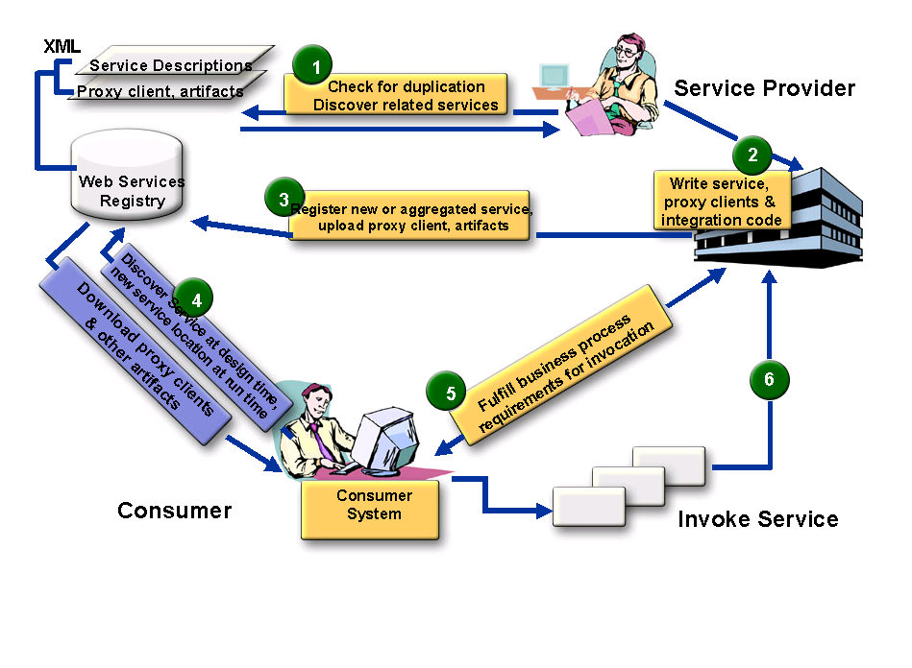

SOA Three Party Model with More Detail
Service Broker
5
4
Define policies: visibility,
access, lifecyle stage, etc.
Application
builder
Service Administrator
Service Consumer
Application Builder
End user
Notes:
Checking repo
“
“
Admin tests
Lookup Serv repo for reqd service, if there download & use it or use it as a proxy instead of writing ur own service.
Serv Broker[e.g. Gappstore] will verify ur service bfr making it public.

Slide 80
Different Kinds of Service Brokers
Service
Brokers
OASIS Standard
UDDI Registry
Limited
automation
OASIS Standard
ebXML Integrated
Registry/Repository
Extensive
automation
Ad Hoc
Registry / List
Quick start
Manual
search
Large IT companies
MS, IBM, SAP, HP
Small / Medium IT
Non IT (Boeing)
Government. Also,
Medical domain
Small companies
www.programmableweb.com/
ASU Repository
Your Project 3
Notes:
UDDI is a Std. ; it’s only a Register[~table] no repo[i.e., no services (implementation)]
Ad Hoc doesn’t follow any Std.
Designed for Human reading [ Man will search 4 wsdl service & manually bind it]
Not much automation

Slide 81
Who is OASIS?
OASIS is a member-led, international non-profit standards consortium;
Founded under the name "SGML Open" in 1993.
Thousands of individual and organizational members in 100 countries;
The largest standards group for SOA and Web services. Most SOA standards are from OASIS
Supports over 60 technical committees producing royalty-free and RAND (Reasonable and non-discriminatory) licensing in an open process.

Slide 82
UDDI Service Registry
Universal Description, Discovery, and Integration
UDDI registry information is organized in three groups:
White pages include service provider's name, identify, e.g., the DUNS number, contact information.
Yellow pages include industry type, product and service type, and geographical location.
Green pages include five data structures and APIs for allowing computer programs to read and write (register) UDDI registry.
We will discuss the full details of UDDI in Chapter 3
Notes:
UDDI is most used registry.

Slide 83
ebXML Consists of Five Modules
http://www.ebxml.org/
Similar to BPEL and Workflow Foundation
Business Process Specification Schema
Core Components
Collaboration Protocol Profiles and Agreements (CPPA)
Message Service
https://www.oasis-open.org/committees/ebxml-msg/documents/ebMS_v2_0.pdf
Registry & Repository
ebXML Message
Format
Notes:
ebXML is a bigger package then UDDI.
It has dynamic protocol.
Message Service //ar to Enterprise Bus.

Slide 84
ebXML Vendor Products
Sun Microsystems Inc.
ebXMLsoft Inc.
CHECKMi
Digital Artefacts Inc.
Adobe Systems Inc.
freebXML Registry (open source)
Infravio - X-registry
Xenos Group Inc. – GoXML Registry
Widely used in healthcare systems and government systems
Notes:
Oracle loves UDDI

Slide 85
What is ebXML?
An SOA registry as well as a repository
  Classification of any type of information
  Managing relationships between information
  Taxonomy hosting, browsing and validation
  File/folder organization of information
A content management system for secure & federated information
  Provides services for sharing content and metadata between entities in a federated environment
  Lifecycle Management (LCM) actions logged in an audit trail
  Supports automatic versioning of objects

Slide 86

ebXML Registry Key Features
Registration,
Discovery, Queries
ebXML
Registry
Federated Queries,
Inter-registry links
Registry
Repository
Taxonomies, Classifications, Associations
Federated Information Manage-
ment
Standard Metadata
Secure Architecture
Content management
Cataloging,
Content Validation,
Version Control,
Lifecycle Support,
Extensible
Information Model
Digital Signatures,
Audit Trail,
Access Control,
SAML Single Sign-On
Events
Content-Based
Event Notification

Slide 87
Need for an Integrated SOA Registry/Repository
Governance enforced where SOA artifacts are stored
Registry is not enough – need repository
  Repository stores the actual artifacts
  Registry stores metadata about the artifacts
An integrated registry/repository ensures consistent storage, management, and reuse of artifacts according to organizational policies
ebXML registry provides an integrated registry/repository
Empower service providers without their own servers

Slide 88
Federated Information Management
Multiple ebXML registries may be federated together to
  appear as a single virtual registry/repository
  support seamless information integration and sharing
  allow local autonomy over data
ebXML federated registry relies on SAML (Security Assertion Markup Language) – the federated identity management standard
Notes:
SAML is predecessor of XML

Slide 89
Case Study:
Government of Canada/Ontario
Vision: Improve service quality to Canadian people and businesses through cost-effective eServices at all levels of government
Target: Leverage the power of XML to deliver those services via collaboration across jurisdictions
Strategy: Enable service delivery infrastructure by utilizing a federated registry and repository
Notes:
In older days, Services were called us XML. Now we just call them Web Services.

Slide 90

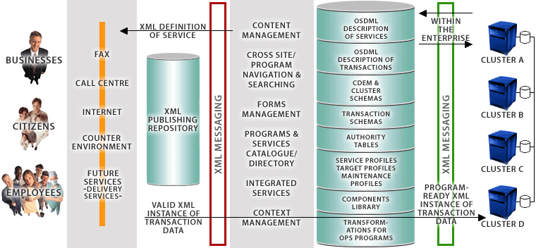




Government of Canada’s Registry/Repository enables Four-Tier e-Government Architecture
ebXML Registry/
Repository
End Users
eContact
CSDML
CBSC
META DATA
CALL CENTRE
CLUSTER
SCHEMAS
PORTAL
CSPN
TRANSACTION
SCHEMAS
COUNTER
ENVIRONMENT
SECURITY
CPSIN
FUTURE
SERVICES
- DELIVERY
SERVICES -
GSRM Models
BizPal
COMMON
COMPONENTS
TRANSFORMATIONS
FOR PS PROGRAMS
Presentation
Layer
ApplicationLayer
XML Integration
Layer
Back-End
Layer
Source: Government of Canada

Slide 91
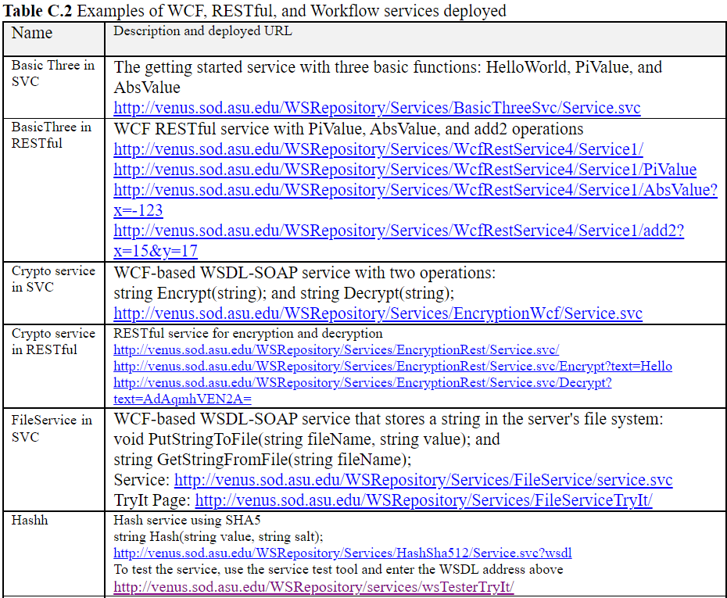
ASU Repository of Web Services and Web Applications
http://venus.sod.asu.edu/WSRepository/repository.html

Slide 92
HTTPS Access to ASU Repository
HTTPS: HTTP with SSL (Secure Sockets Layer)
Starting from 2022, ASU requires all accesses to ASU servers to use HTTPS, instead of HTTP.
When you develop a Web application to invoke WSDL web services in ASU Repository, you must use https.
You can open the Web.config file of your Web application and change all http to https and http bindings to https bindings

Slide 93
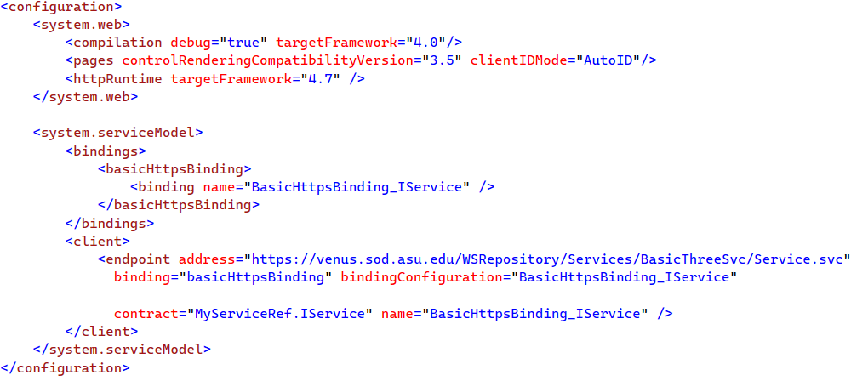
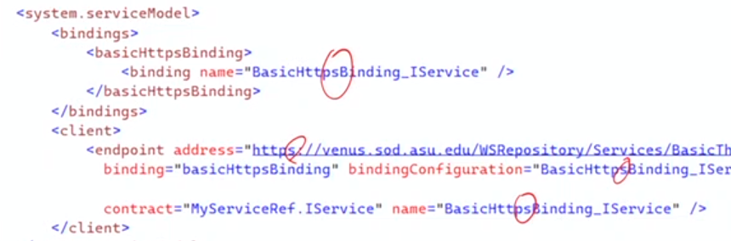
Example

Slide 94
Roadmap
Basic Concepts
XML, SOAP, WSDL
Web Services
Service Registry and Repository
Application Building
SOA Impact
Myths and
Facts
Service brokers
Registry
Registry
Application builder
Service providers
Applications
Web Services

Slide 95
Process of Application Building in SOA Style
Architecture-Drive Approach
Oracle SOA Suite
Visual Studio WF
Architecture / Component Interface
Level Specification
IBM WebSphere SCA / SDO
Amazon Simple Workflow SWF
CSE446 (Integration)
IBM WSFL’s Flow Model
Process / Workflow
Level Specification
Microsoft XLANG
BPEL
OWL-S
Code-Level (C#, Java, Python)
Assembling and Binding of Components
WSDL
SOAP
CSE445 (Development)
HTTP / RESTful
Deployment
Remote Desktop
FTP / WebDev
Management
IDE (e.g., ebXML, VS)
IDE (e.g., ebXML, VS)

Slide 96
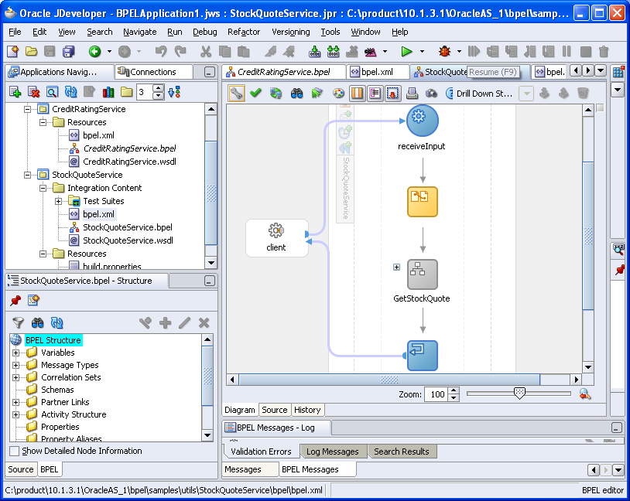
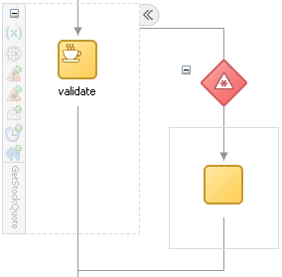
Oracle SOA Suite: StockQuoteService
BPEL composition with WSDL interface
Notes:
U can connect services using GUI in oracle SOA suite, u don’t have to code it manually. Just drag & drop.

Slide 97
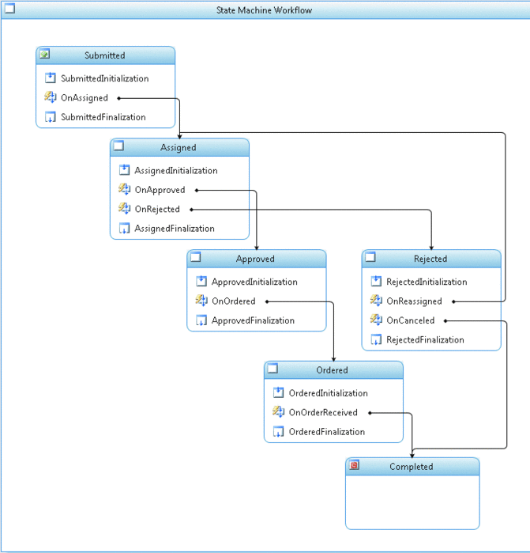
Microsoft
Workflow
Foundation
Submitted
Assigned
approve
Approved
Rejected
reassign
cancel
Ordered
Completed
Notes:
As of March 2023, Windows Workflow Foundation (WF) is no longer supported in the new .NET 8

Slide 98
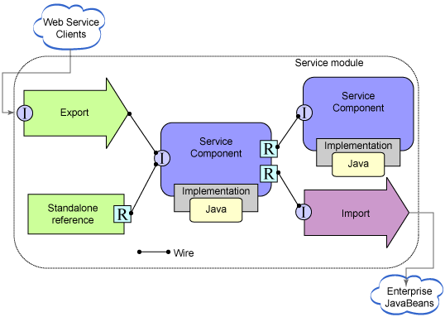
Service Component Architecture (SCA)
Service Data Object (SDO)
https://www.ibm.com/support/knowledgecenter/en/SSMKHH_10.0.0/com.ibm.etools.mft.doc/ac68550_.htm
Notes:
First, create all ur reqd. service components and then just drag and drop.

Slide 99
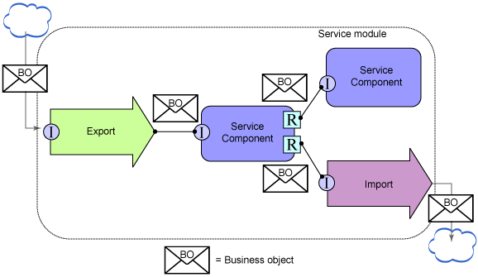
Service Component Architecture (SCA)
Service Data Object (SDO)
Notes:
Soap is basically a text obj.
ebXML allows soaps with attachment.

Slide 100
BPEL
BPEL is jointly developed by multiple companies
A global model consists of partners and partner links
A flow model defines the workflow
BPEL provides constructs to specify the data and control flows, including:
    Assign
    Condition
    Switch
    Loop
    etc.
BPEL will be studied in detail in the next course

Slide 101
Impact of SOA/SOC Paradigm
Explicit differentiation between software engineers and programmers (Three-Party Development Model)
Application builders (software engineers) do not have to focus on programming in the small
Programmers do not have to understand application domain
Tougher but equal competition
Shorter development cycle
Better and more reliable software from specialized providers
Different skill requirements:
  Fewer programmers-only jobs may be needed, as reuses increase, automated/AI programming, etc.
  More software engineers (CS/CSE/SE graduates) will be needed, as applications increase
Notes:
In SOC, we(CS) focus on writing classes[~Service] to address an block.
App builder focus on solving client’s probe using those classes.

Slide 102
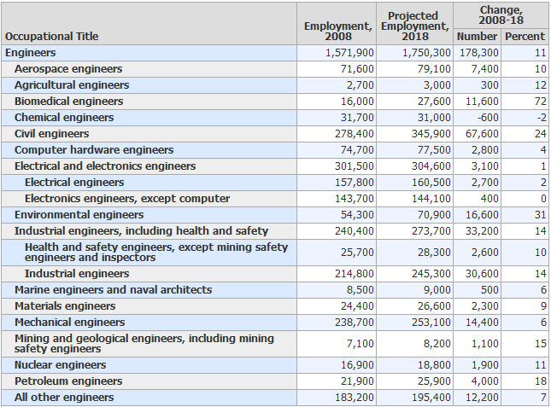
Engineers (U.S. DoL OCO Handbook 2010-2011) http://www.bls.gov/ooh/
All Engineers
1,571,900 1,750.300 11

Slide 103
Software Engineers and CS Occupations (There are many more) in U.S. DoL Occupational Outlook Handbook 2010-2011
All Engineers
1,571,900 1,750.300 11
Occupational title | Employment in 2008 | Employment in 2018 | Change in number | Change in percentage
Computer software engineers | 909,600 | 1,204,800 | 295,200 | 32
Computer systems analysts | 532,200 | 640,300 | 108,100 | 20
Computer network, systems, and database administrators | 961,200 | 1,247,800 | 286,600 | 30
Computer programmers | 426,700 | 414,400 | -12,300 | -3
Computer support specialists | 565,700 | 643,700 | 78,000 | 14
Computer and information systems managers | 293,000 | 342,500 | 49,500 | 17
2,7788
3,2887

Slide 104
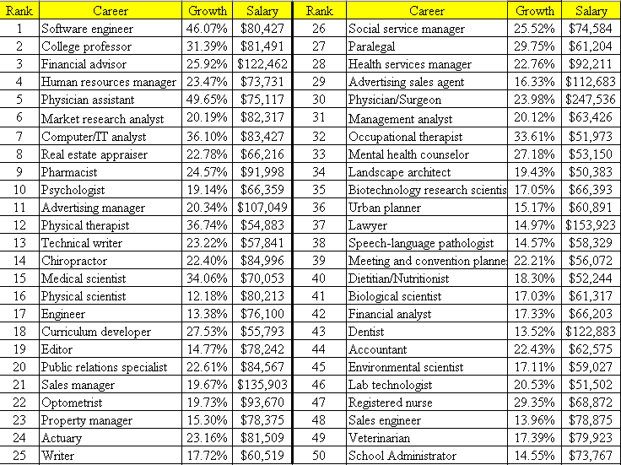
April 12, 2006
http://money.cnn.com/magazines/moneymag/bestjobs/top50/index.html

Slide 105

2010
http://money.cnn.com/magazines/moneymag/bestjobs/2010/sectors/#I
Sector
Job Title | Rank in top 40
Software Architect | 1
Database Administrator | 7
Information Systems Security Engineer | 17
Software Engineering / Development Director | 18
Information Technology Manager | 20
Telecommunications Network Engineer | 21
Network Operations Project Manager | 24
Information Technology Business Analyst | 26
Information Technology Consultant | 28
Test Software Development Engineer | 30
Information Technology Network Engineer | 31
Information Technology Program Manager | 33
Computer and Information Scientist | 35
Programmer Analyst | 37
Applications Engineer | 38
Information Technology
15
40

Slide 106
2012
Rank | Job Title | Median Salary | 2011 Job number | 10 year growth rate | 2021 Job number
1 | Biomedical Engineer | $79,500 | 15,700 | 61.7% | 25,387
2 | Marketing Consultant | $92,100 | 282,700 | 41.2% | 399,172
3 | Software Architect | $119,000 | 3,426,000 | 24.6% | 4,268,796
4 | Clinical Research Associate | $90,700 | 100,000 | 36.4% | 136,400
5 | Database Administrator | $87,200 | 110,800 | 30.6% | 144,705
6 | Financial Adviser | $90,200 | 206,800 | 32.1% | 273,183
7 | Market Research Analyst | $63,100 | 282,700 | 41.2% | 399,172
8 | Physical Therapist | $76,700 | 198,600 | 39.0% | 276,054
9 | Software Developer | $84,200 | 3,426,000 | 24.6% | 4,268,796
10 | Occupational Therapist | $74,900 | 108,800 | 33.5% | 145,248
11 | Management Consultant | $110,000 | 718,800 | 21.9% | 876,217
12 | Optometrist | $105,000 | 34,200 | 33.1% | 455,20
13 | IT Consultant | $96,400 | 544,400 | 22.1% | 664,712
14 | IT Network Engineer | $73,400 | 347,200 | 27.8% | 443,722
15 | IT Security Consultant | $102,000 | 347,200 | 27.8% | 443,722

Slide 107
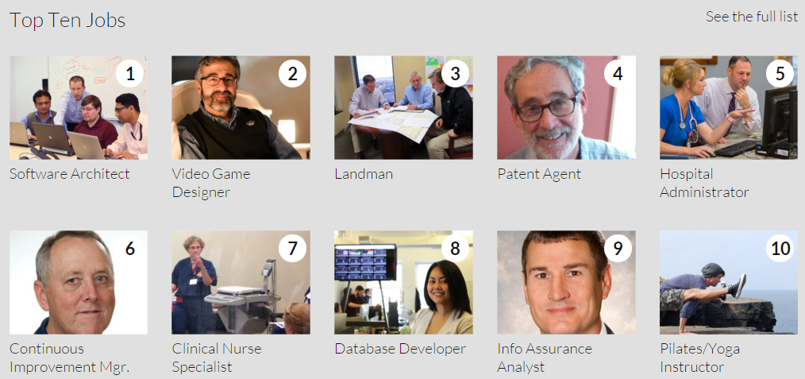
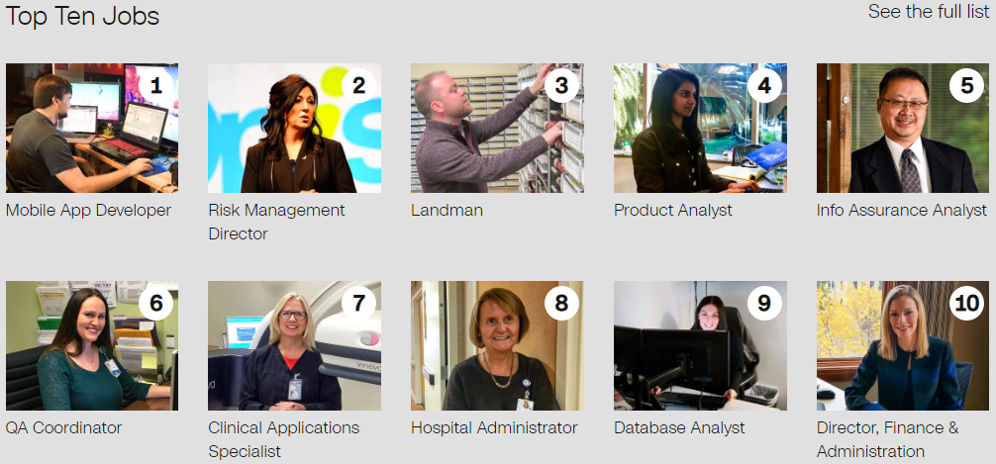
http://money.cnn.com/pf/best-jobs/
2015
In top 50:
17 IT Program Manager
32 Software Quality Assurance Manager
38 IT Security Consultant
2017
In top 50:
13 Information Tech Director
14 Webmaster
22 IT Operations Manager
33 Video game designer
35 IT Training Specialist
38 IT Business Analyst
50 IT Security Director

Slide 108

100 Best Jobs US News 2021
https://money.usnews.com/careers/best-jobs/rankings/the-100-best-jobs
Job Title | Job # | Median Salary | Degree needed
1. Physician Assistant | 39,300 | 112,260 | Master’s
2. Software Developer | 316,000 | 107,510 | Bachelor’s
3. Nurse Practitioner | 110,700 | 109,820 | Master’s
4. Medical and Health Services Manager | 133,200 | 100,980 | Bachelor’s
5. Physician | 18,500 | 206,500 | Doctorate
6. Statistician | 14,800 | 91,160 | Master’s
7. Speech-Language Pathologist | 40,500 | 79,120 | Master’s
8. Data Scientist | 10,300 | 94,280 | Bachelor’s
9. Dentist | 3,700 | 155,600 | Doctorate
10. Veterinarian | 14,200 | 95,460 | Doctorate
11. Orthodontist | 200 | 208,000 | Doctorate
12. IT Manager | 48,100 | 146,360 | Bachelor’s
Summary: Medical related jobs | 280,500 |  | Master/Doctor
Summary: Computing related jobs | 389,200 | x 1.39 | Bachelor

Slide 109
100 Best Jobs US News 2023
https://money.usnews.com/careers/best-jobs/rankings/the-100-best-jobs
Job Title | Job # | Median Salary | Degree needed
1. Software Developer | 370,600 | 120,730 | Bachelor’s
2. Nurse Practitioner | 112,700 | 120,680 | Master’s
3. Medical and Health Services Manager | 136,200 | 101,240 | Bachelor’s
4. Physician Assistant | 38,400 | 121,530 | Master’s
5. Information Security Analyst | 56,500 | 102,600 | Bachelor’s
6. Physical Therapist | 40,400 | 95,620 | Doctorate
7. Financial Manager | 123,100 | 131,710 | Bachelor’s
8. IT Manager | 82,400 | 159,010 | Bachelor’s
9. Web Developer | 28,900 | 77,030 | Bachelor’s
10. Dentist | 7,700 | 160,370 | Doctorate
11. Lawyer | 80,200 | 127,990 | Doctorate
12. Veterinarian | 16,800 | 100,270 | Doctorate
Summary: Medical related jobs | 352200 |  | Master/Doctor
Summary: Computing related jobs | 538400 | x 1.53 | Bachelor

Slide 110
Myths and Facts of SOA (2015)
https://www.macrosoftinc.com/myths-and-facts-of-service-oriented-architecture-soa/
Myth | Fact
SOA is a technology. | SOA is a design philosophy independent of any product, technology, or industry trend.
SOAs require Web Services. | SOAs can be realized using Web services, but using Web services will not necessarily result in a SOA.
SOA is new and revolutionary. | EDI (Electronic Data Interchange), CORBA, and DCOM were conceptual examples of SOA.
SOA ensures the alignment of IT and business. | SOA is not a methodology.
A SOA Reference Architecture reduces implementation risk. | SOAs are like snowflakes: No two are the same.
SOA requires a complete technology and business-processes overhaul. | SOA should be incremental and built on your current investments.
SOA requires an army of consultants. | SOA requires tools, not consultants.
We need to build a SOA. | SOA is a means, not an end.

Slide 111
Seven Fallacies of SOA
https://doveltech.com/innovation/seven-fallacies-of-soa/
By Jason Bloomberg
There's Nothing New Under the Sun, and SOA Is No Exception;
SOA is a Revolutionary Paradigm Shift;
SOAs are All Hype, No Substance;
SOA is a Panacea;
The Overhead from SOA Leads to Unacceptably Poor Performance;
A Bottom-Up Approach to SOA is Good Enough;
SOA is Optional.

Slide 112
How Does SOA Address the DC Fallacies ?
SOA does not have to be Web based. All services could be local! SOA is independent of topology;
platform; and
location.
Will be discussed in later chapter
The network is reliable.
Latency is zero.
Bandwidth is infinite.
The network is secure.
Topology doesn't change.
There is one administrator.
Transport cost is zero.
The network is homogeneous
Race between communication and computing: who wins?
Latency and bandwidth, which one is harder to resolve?
Moore's law: processor power, network speed, and storage size are all increasing even as their costs drop
Will be discussed in later chapter
SOA uses end-to-end communication
Orchestration (central controlled) versus Choreography (distributed)
This is one of the costs of distribution
SOA is platform independent!

Slide 113
SUMMARY of CHAPTER 1
Computer Architecture and Software Architecture
Distributed Software Architectures
  Client-Server Architecture (Two-Tier Architecture)
  Three-Tier and Four-Tier architecture
  Distributed Object Architecture
Service-Oriented Architecture and Concepts
  Standards: XML, WSDL, SOAP
  Service providers, Brokers, and Application builders
  SOA Impact

